Slide 1
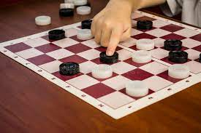
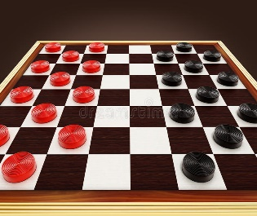
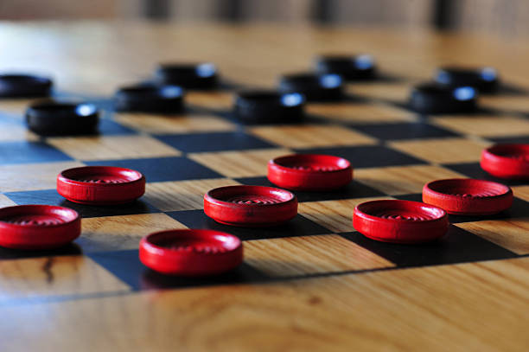
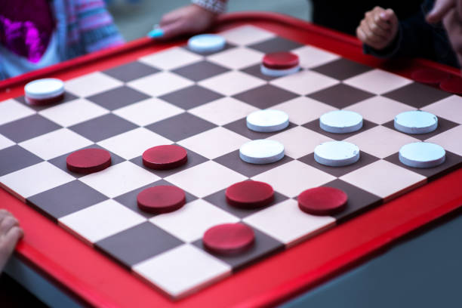
ALLPPT.com _ Free PowerPoint Templates, Diagrams and Charts
Checker game python
By
Abdul Qayyum
Hassan Raheem

Slide 2
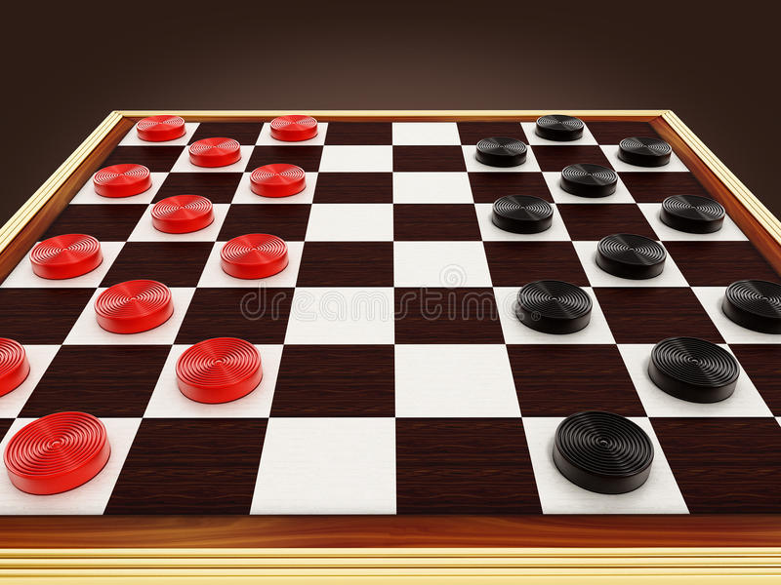
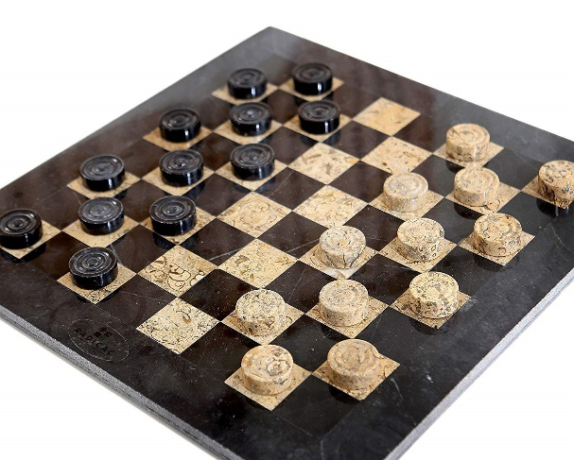
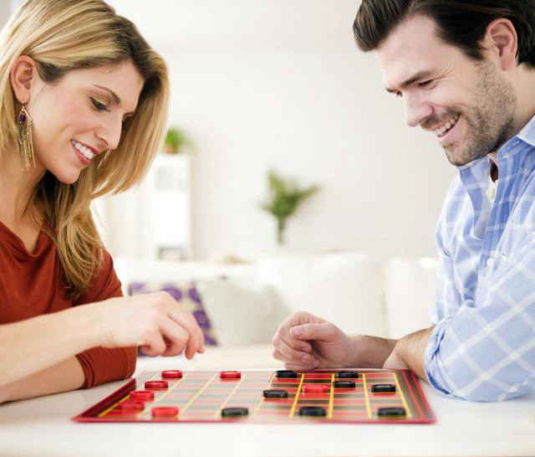
Introduction
checkers, also called draughts, board game, one of the world’s oldest games. Checkers is played by two persons who oppose each other across a board of 64 light and dark squares, the same as a chessboard. The 24 playing pieces are disk-shaped and of contrasting colours (whatever their colours, they are identified as black and white). At the start of the game, each contestant has 12 pieces arranged on the board. While the actual playing is always done on the dark squares, the board is often shown in reverse for clarity. The notation used in describing the game is based on numbering the squares on the board. The black pieces always occupy squares 1 to 12, and the white pieces invariably rest on squares 21 to 32.

Slide 3
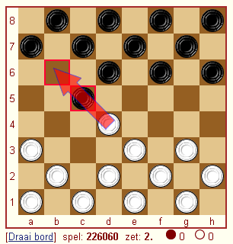
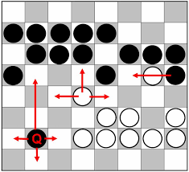
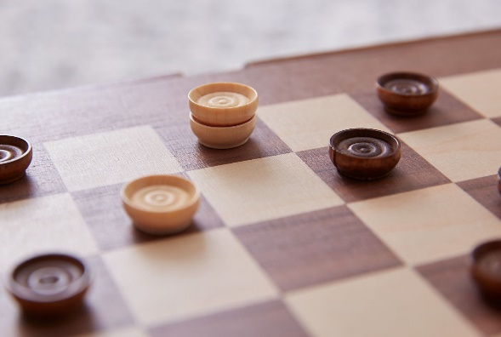
Rules of the game
Movement rules
Always move your checker diagonally forward, toward your opponent’s side of the game board.
Note :After a checker becomes a “King” it can move diagonally forward or backward.
Move your checker one space diagonally, to an open adjacent square; or jump one or more checkers diagonally to an open square adjacent to the checker you jumped. When you jump over an opponent’s
checker, you capture it.
If all squares adjacent to your checker are occupied, your checker is blocked and cannot move.

Slide 4
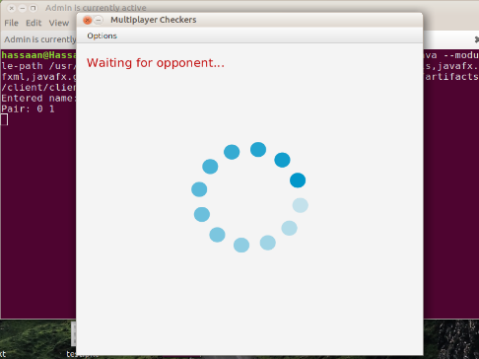
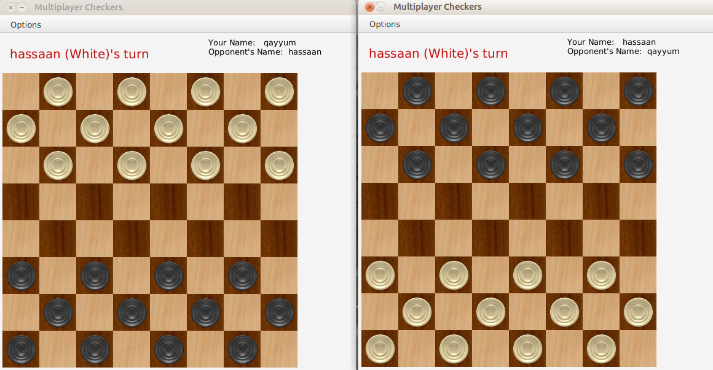
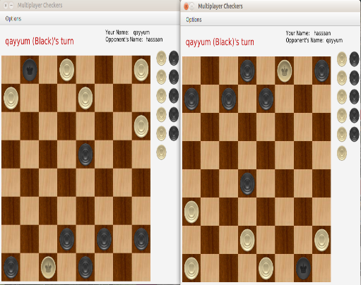

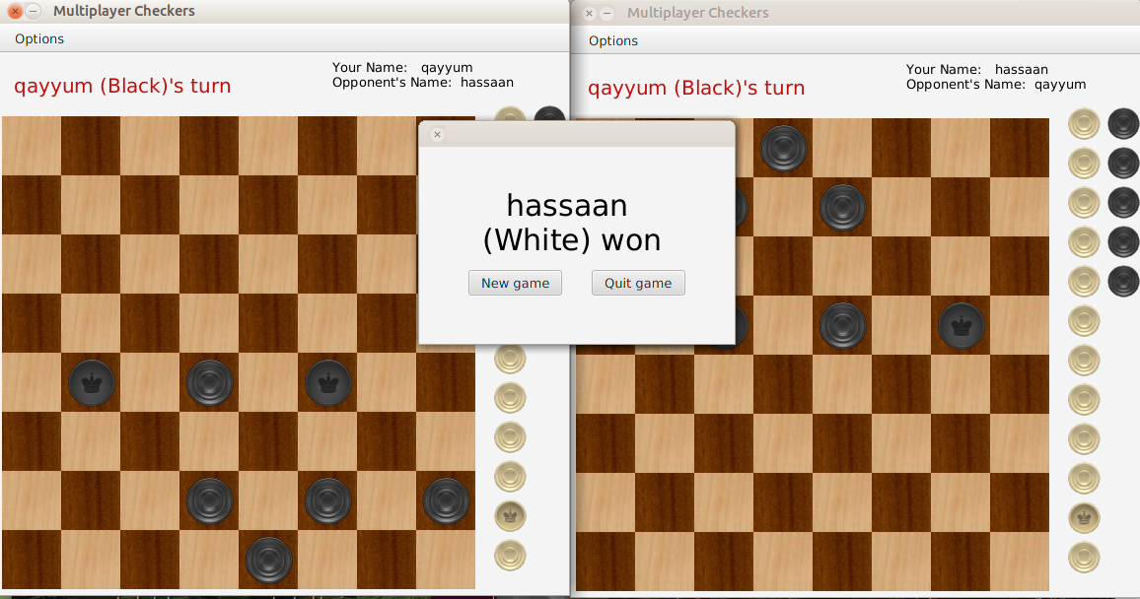
Project Pictures

Slide 5

CONCLUSION
The aim of this project was to develop a networking based program that works in a more natural way than the standard idea of how a draughts game should work. This was done by aiming more for a system of calculating the moves on a basis that relied not on a total omniscient idea of controlling everything that occurs on the board and having a fixed response or series of responses preprogrammed into the code but for the code to consider each move in isolation from every other move and to make its judgments based on the best move in the given situation. This is coupled with the concept of a program having its own history which is able to influence but not necessarily dominate the individual decisions that are made about each move.

